Slide 1
SmartScreen

Slide 2
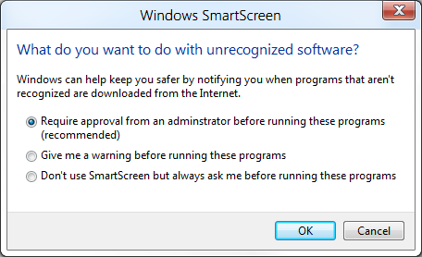
Change “notifying you” to “letting you know”
Change “Require approval” to “Get approval”
Fix spelling of “administrator”

Slide 3
unsigned
This program might not be safe to run
This program was downloaded from the Internet. Windows SmartScreen is currently unavailable and can’t help you decide if this program is safe.
Run Don’t run

Slide 4
Signed
SmartScreen can’t check this program right now
This program was downloaded from the Internet. Windows SmartScreen is currently unavailable and can’t help you decide if this program is safe.
Publisher: Apple Inc.
Program: iTunes.exe
Run Don’t run

Slide 5
Windows protected your computer
Windows SmartScreen prevented an unrecognized program from starting. You need administrator approval to run this program.
Jay Thomas
jaythomas@hotmail.com
Enter administrator password
Run
Don’t run

Slide 6
Windows protected your computer
Windows SmartScreen prevented an unrecognized program from starting. Running this program might put your computer at risk. More options
Tom, clicking “More options” gives you the control that lets you run the program. This has been proven to greatly reduce the percentage of people who screw themselves by running a virus-laden program or other bad thing.
OK

Slide 7
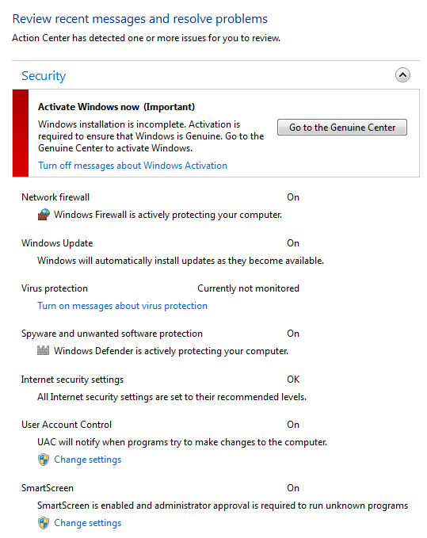
Tom, please just review the SmartScreen section
SmartScreen is turned on, and you need administrator approval to run unrecognized programs downloaded from the Internet.

Slide 8

SmartScreen is turned on, and people with standard user accounts can run unrecognized programs downloaded from the Internet.

Slide 9
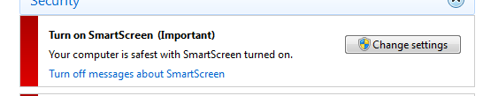
Your computer is safer with SmartScreen turned on.
Changed “safest” to “safer”

Slide 10
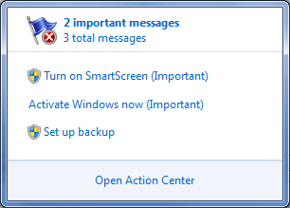
No changes here.

